Slide 1
Lecture 18: Minimum Spanning Trees

Slide 2



Minimum Spanning Tree
Minimum spanning tree. Given a connected undirected graph $G=(V, E)$with real-valued edge weights $w(e)$, an MST is a subset of the edges $T⊆E$ such that $T$ is a tree that connects all nodes whose sum of edge weights is minimized.
Applications: telephone, electrical, hydraulic, TV cable, computer, road
4
24
4
6
23
9
9
18
6
5
11
5
11
16
8
8
10
14
7
7
21
$$G=(V, E)$$
$$T, eT w(e)=50$$

Slide 3


Prim's Algorithm: Idea
Prim's algorithm
Initialize $S$ = {any one node}.
Add min cost edge $e=(u,v)$ with $u∈S$ and $v∈V−S$ to $T.$
Add $v$ to $S$.
Repeat until $S=V$
$$S$$

Slide 4
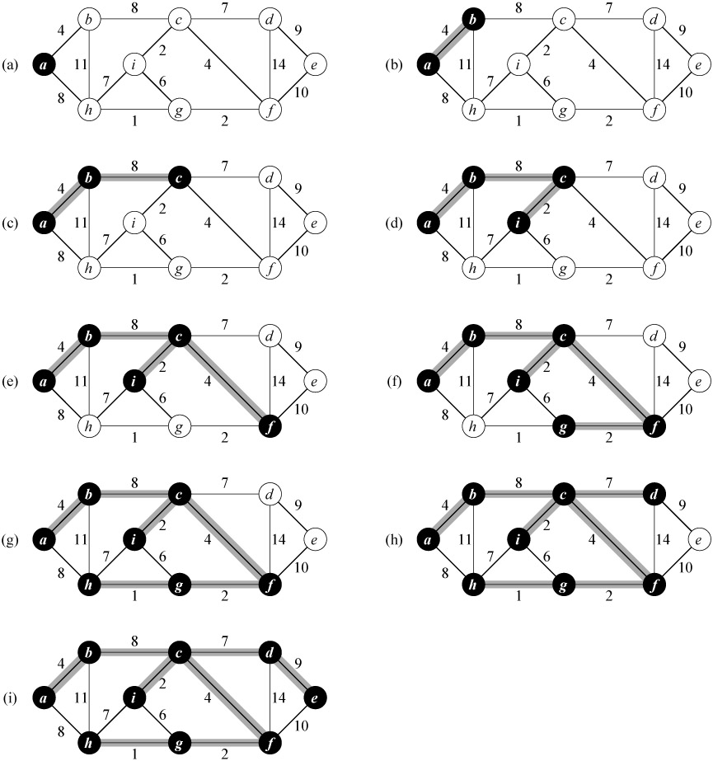
Prim’s Algorithm: Example

Slide 5
Prim’s Algorithm: Example (continued)

Slide 6



Prim's Algorithm: Implementation
Implementation.
Maintain set of explored nodes $S$.
For each unexplored node $v$, maintain the cheapest edge from $v$ to a node in $S$.
Maintain all nodes in a priority queue with this cheapest edge as key
Prim($G, r$):
for each $v∈V$ do
$v.key←∞$,$v.p←nil$,$v.color←white$
$r.key←0$
create a min priority queue $Q$ on $V$
while $Q≠∅$
$u←$Extract-Min($Q$)
$u.color←black$
for each $v∈Adj[u]$ do
if $v.color=white$ and $w(u, v)<v.key$ then
$v.p←u$
$v.key←w\left(u,v\right)$
Decrease-Key($Q,v, w(u, v)$)
Note: In the end, the parent pointers form the MST.
Running time: $O(E\log{V)}$
Q: Decrease-key needs the location of the key in the heap. How to get that?

Slide 7

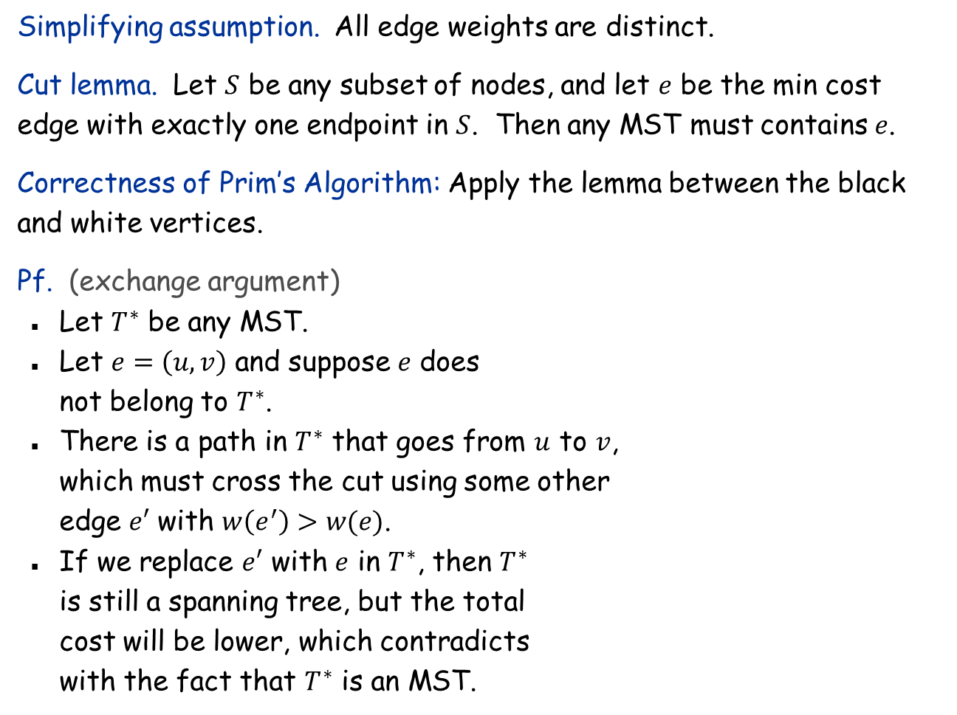





Cut Lemma
Simplifying assumption. All edge weights are distinct.
Cut lemma. Let $S$ be any subset of nodes, and let $e$ be the min cost edge with exactly one endpoint in $S$. Then any MST must contains $e$.
Correctness of Prim’s Algorithm: Apply the lemma between the black and white vertices.
Pf. (exchange argument)
Let $T^{∗}$ be any MST.
Let $e=\left(u,v\right)$ and suppose $e$ does not belong to $T^{∗}$.
There is a path in $T^{∗}$ that goes from $u$ to $v$, which must cross the cut using some other edge $e′$ with $w\left(e^{′}\right)>w(e)$.
If we replace $e′$ with $e$ in $T^{∗}$, then $T^{∗}$ is still a spanning tree, but the total cost will be lower, which contradicts with the fact that $T^{∗}$ is an MST.
$$S$$
$$e$$
e is in the MST
$$e’$$
$$S$$
$$e$$
$$T^{∗}$$

Slide 8
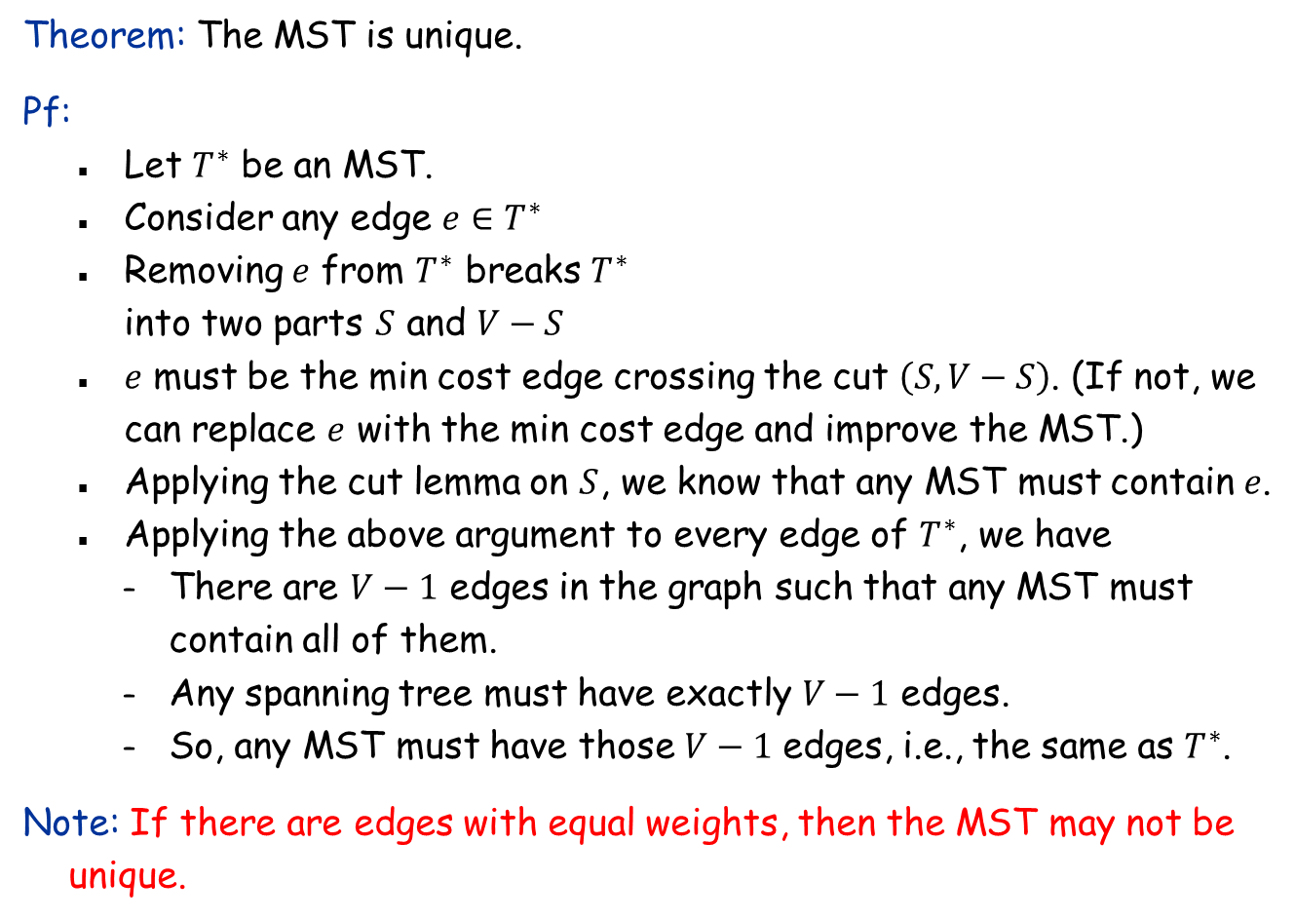
Uniqueness of MST
Theorem: The MST is unique.
Pf:
Let $T^{∗}$ be an MST.
Consider any edge $e∈T^{∗}$
Removing $e$ from $T^{∗}$ breaks $T^{∗}$ into two parts $S$ and $V−S$
$e$ must be the min cost edge crossing the cut $\left(S, V−S\right)$. (If not, we can replace $e$ with the min cost edge and improve the MST.)
Applying the cut lemma on $S$, we know that any MST must contain $e$.
Applying the above argument to every edge of $T^{∗}$, we have
There are $V−1$ edges in the graph such that any MST must contain all of them.
Any spanning tree must have exactly $V−1$ edges.
So, any MST must have those $V−1$ edges, i.e., the same as $T^{∗}$.
Note: If there are edges with equal weights, then the MST may not be unique.
4
6
9
5
11
8
7

Slide 9




Kruskal's Algorithm: Idea
Kruskal's algorithm.
Starts with an empty tree $T$
Consider edges in ascending order of weight.
Case 1: If adding $e$ to $T$ creates a cycle, discard $e$.
Case 2: Otherwise, insert $e=(u, v)$ into $T$ according to cut lemma
v
$$e$$
$$S$$
$$e$$
u
Case 1
Case 2

Slide 10
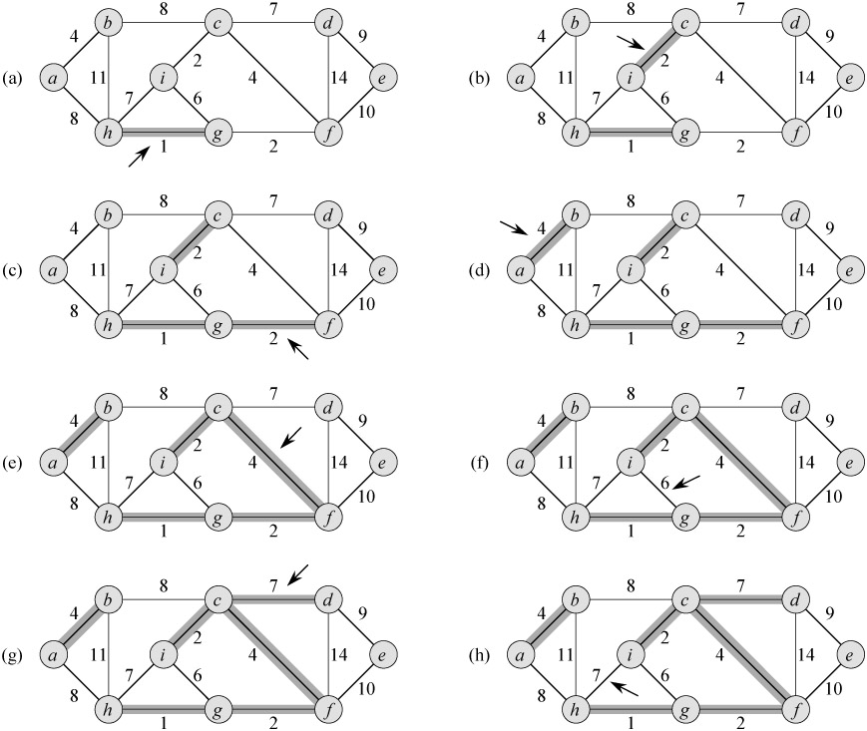
Kruskal’s Algorithm: Example

Slide 11
Kruskal’s Algorithm: Example (continued)

Slide 12
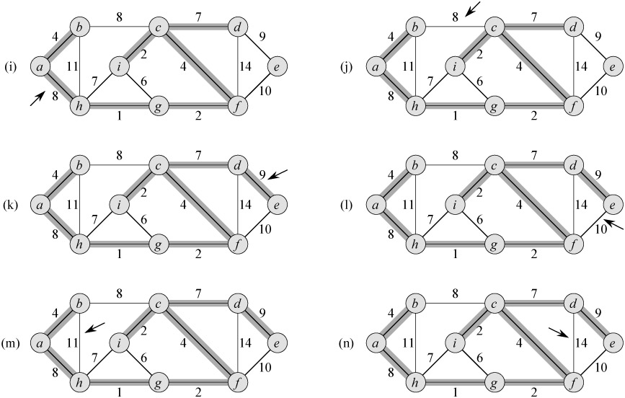
Kruskal’s Algorithm: Example (continued)

Slide 13
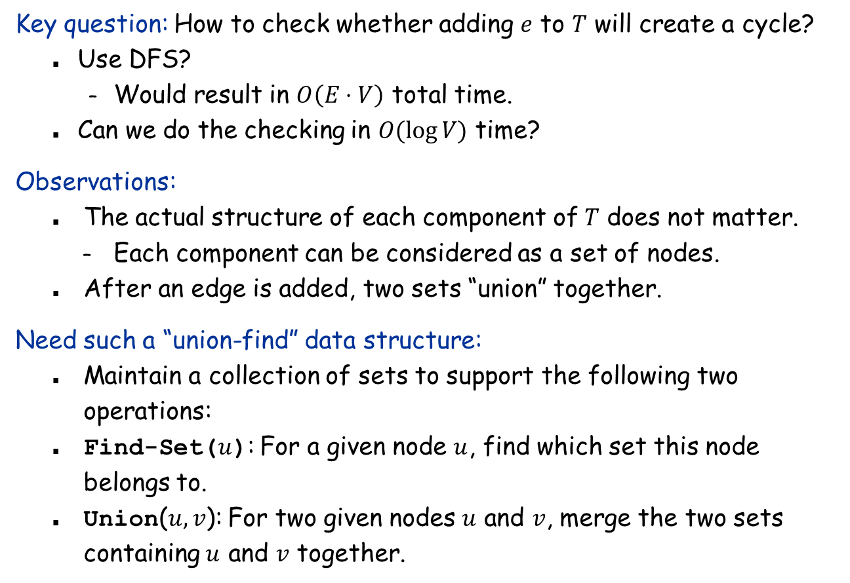
Kruskal's Algorithm: Implementation
Key question: How to check whether adding $e$ to $T$ will create a cycle?
Use DFS?
Would result in $O\left(E⋅V\right)$ total time.
Can we do the checking in $O(\log{V)}$ time?
Observations:
The actual structure of each component of $T$ does not matter.
Each component can be considered as a set of nodes.
After an edge is added, two sets “union” together.
Need such a “union-find” data structure:
Maintain a collection of sets to support the following two operations:
Find-Set($u$): For a given node $u$, find which set this node belongs to.
Union($u,v$): For two given nodes $u$ and $v$, merge the two sets containing $u$ and $v$ together.

Slide 14
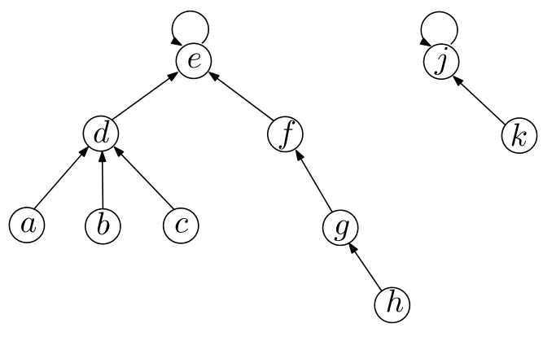
The union-find data structure
Representing each set as a tree:
The tree in the union-find data structure may not be the same as that in the partial MST!
The root of the tree is the representative node of all nodes in that tree (i.e., use the root’s ID as the unique ID of the set).
Every node (except the root), has a pointer pointing to its parent.
The root has a parent pointer to itself.
No child pointers (unlike BST), so a node can have many children.

Slide 15


Make-Set(x) and Find-Set(x)
Create-Set(x):
Find-Set(x):
Running time proportional to the height of the tree.
Make-Set($x$):
$x.parent←x$
$x.height←0$
Find-Set($x$):
while $x!=x.parent$ do
$x←x.parent$
return $x$

Slide 16
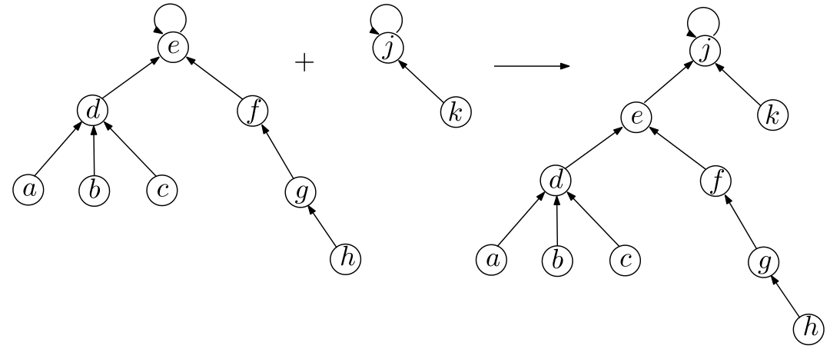

Union(x, y)
Assumption: $x$ and $y$ are the roots of the their trees.
If not, do Find-Set first
Idea: Set $x.parent←y$

Slide 17
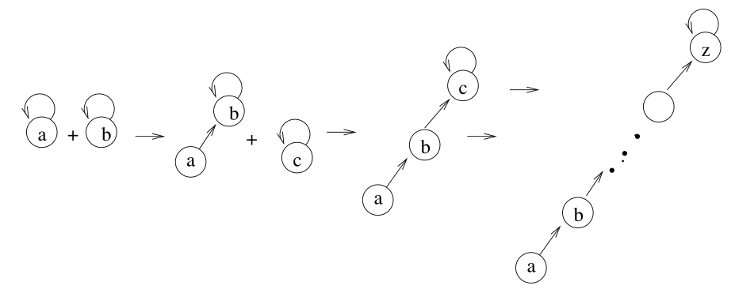
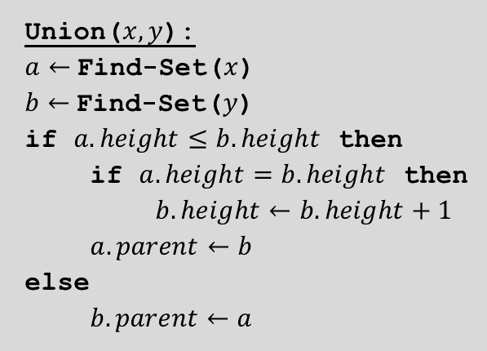
But, what if…
Solution (union by height):
When we union two trees together, we always make the root of the taller tree the parent of shorter tree.
Need to maintain the height of each tree
Union($x, y$):
$a←$Find-Set($x$)
$b←$Find-Set($y$)
if $a.height≤b.height$ then
if $a.height=b.height$ then
$b.height←b.height+1$
$a.parent←b$
else
$b.parent←a$

Slide 18
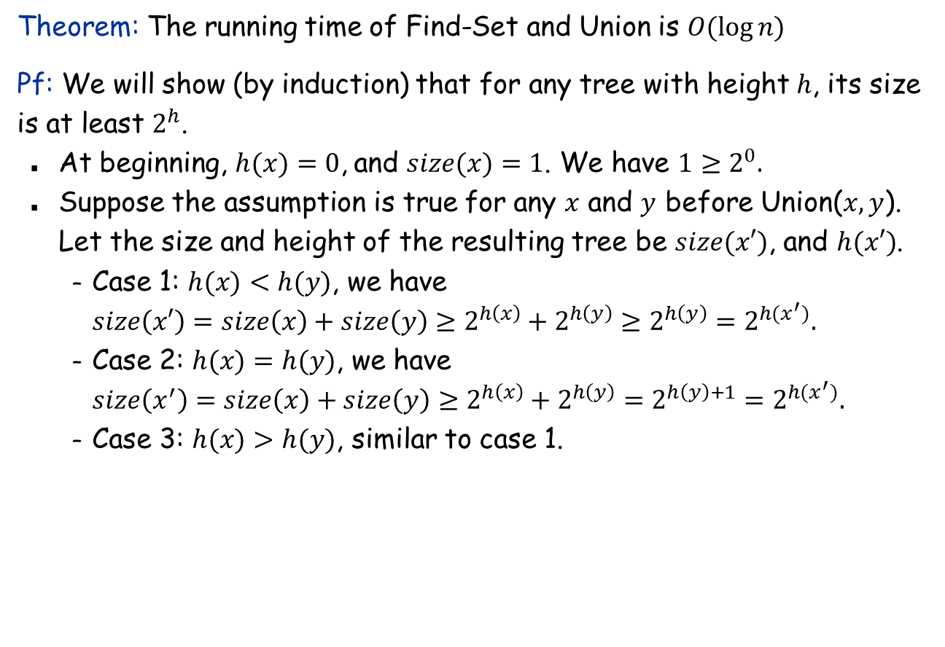
The union-find data structure: Analysis
Theorem: The running time of Find-Set and Union is $O(\log{n)}$
Pf: We will show (by induction) that for any tree with height $h$, its size is at least $2^{h}$.
At beginning, $h(x)=0$, and $size(x)=1$. We have $1≥2^{0}.$
Suppose the assumption is true for any $x$ and $y$ before Union($x,y$). Let the size and height of the resulting tree be $size(x′)$, and $h(x′)$.
Case 1: $h(x)<h(y)$, we have $size\left(x′\right)=size\left(x\right)+size\left(y\right)≥2^{h\left(x\right)}+2^{h\left(y\right)}≥2^{h\left(y\right)}=2^{h(x^{′})}.$
Case 2: $h(x)=h(y)$, we have $size\left(x^{′}\right)=size\left(x\right)+size\left(y\right)≥2^{h\left(x\right)}+2^{h\left(y\right)}=2^{h\left(y\right)+1}=2^{h(x^{′})}.$
Case 3: $h(x)>h(y)$, similar to case 1.

Slide 19
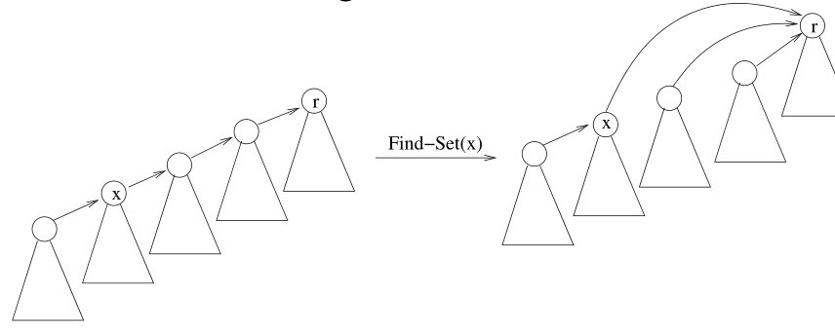
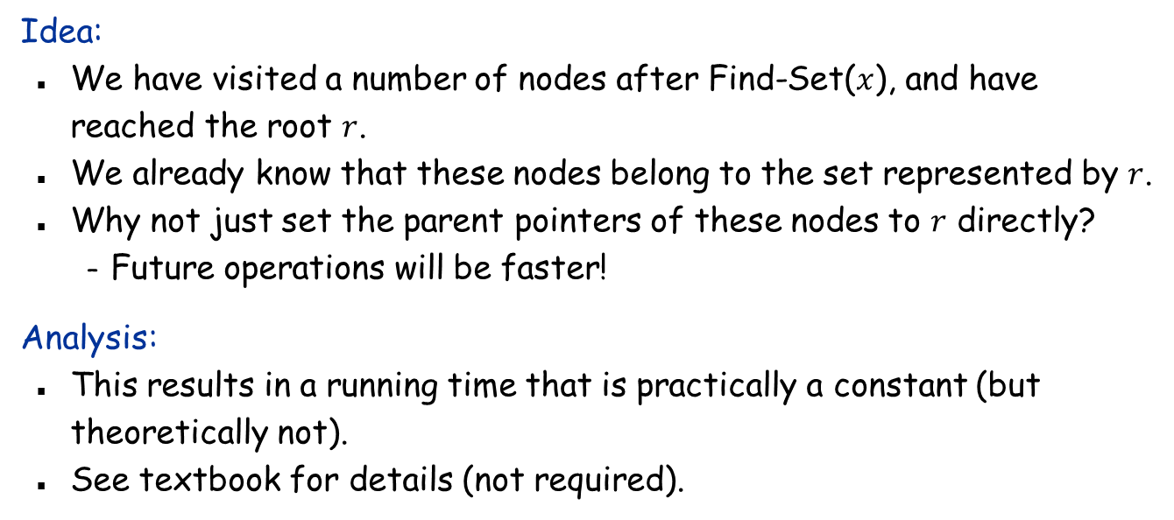
Path Compression
Idea:
We have visited a number of nodes after Find-Set($x$), and have reached the root $r$.
We already know that these nodes belong to the set represented by $r$.
Why not just set the parent pointers of these nodes to $r$ directly?
Future operations will be faster!
Analysis:
This results in a running time that is practically a constant (but theoretically not).
See textbook for details (not required).

Slide 20
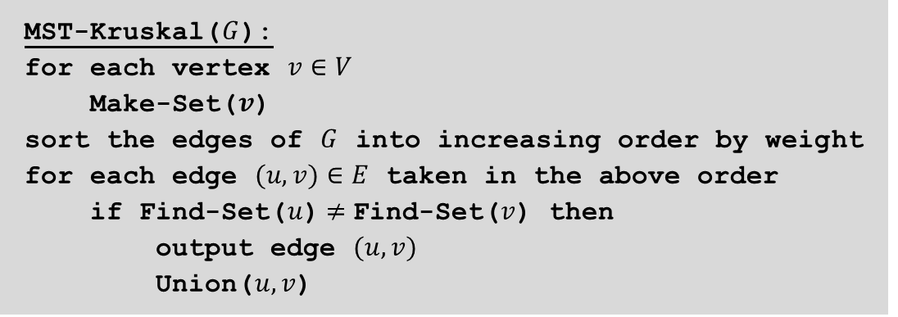
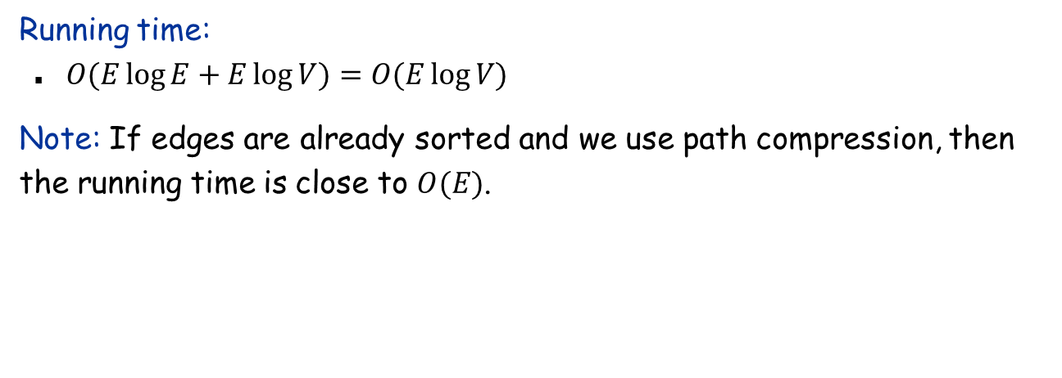
Kruskal’s Algorithm
MST-Kruskal($G$):
for each vertex $v∈V$
Make-Set($v$)
sort the edges of $G$ into increasing order by weight
for each edge $(u, v)∈E$ taken in the above order
if Find-Set($u$)$≠$Find-Set($v$) then
output edge $(u,v)$
Union($u, v$)
Running time:
$O(E\log{E+E\log{V)=O(E\log{V)}}}$
Note: If edges are already sorted and we use path compression, then the running time is close to $O(E)$.

Slide 21

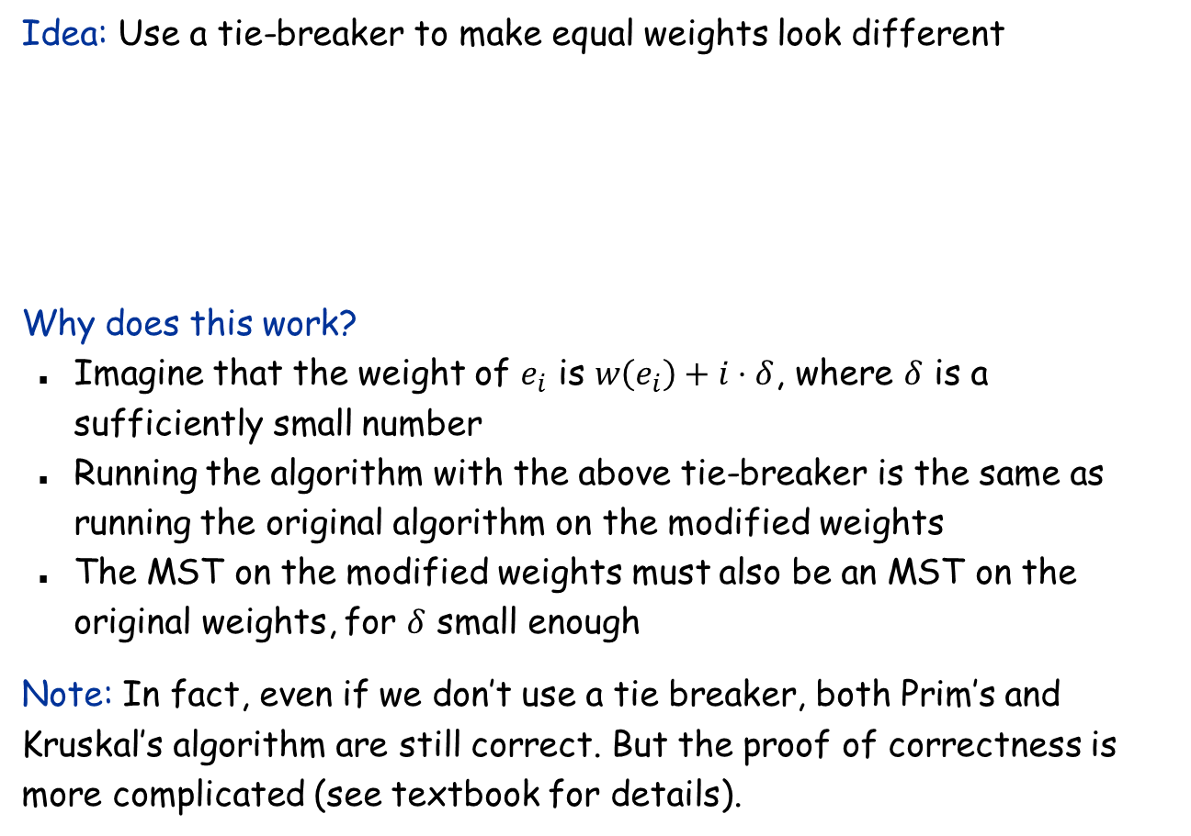
Removing the distinct weight assumption
Idea: Use a tie-breaker to make equal weights look different
Why does this work?
Imagine that the weight of $e_{i}$ is $w\left(e_{i}\right)+i⋅δ$, where $δ$ is a sufficiently small number
Running the algorithm with the above tie-breaker is the same as running the original algorithm on the modified weights
The MST on the modified weights must also be an MST on the original weights, for $δ$ small enough
Note: In fact, even if we don’t use a tie breaker, both Prim’s and Kruskal’s algorithm are still correct. But the proof of correctness is more complicated (see textbook for details).
boolean less($i, j$)
if $w(ei)<w(ej)$ then return true
else if $w\left(ei\right)>w(ej)$ then return false
else if $i<j$ then return true

